Slide 1
Project Title: STP Attacks and Protection Mechanisms This project explores common attacks on the Spanning Tree Protocol (STP), such as BPDU spoofing and root bridge manipulation, and demonstrates effective countermeasures to secure network topology.

Slide 2
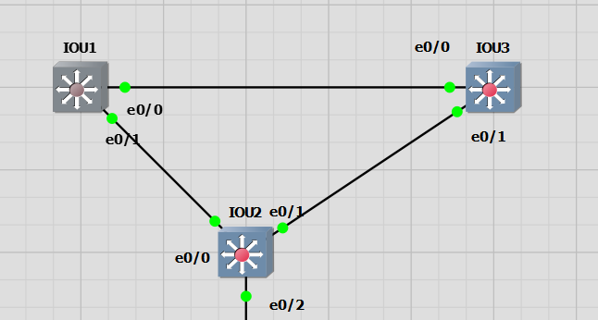













Slide 3
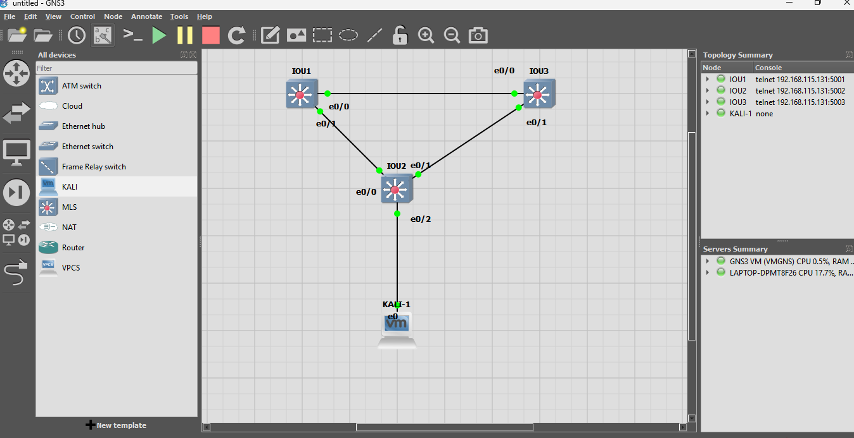

Slide 4
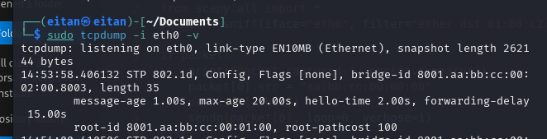


DEC | HEX | Value
32769 – vlan id number gets added to default of 32768 | 8001 aa:bb:cc:00:01:00 | Root Bridge Priority and MAC
128 | 80 | Port-Priority
3 | 3 | Port-id

Slide 5
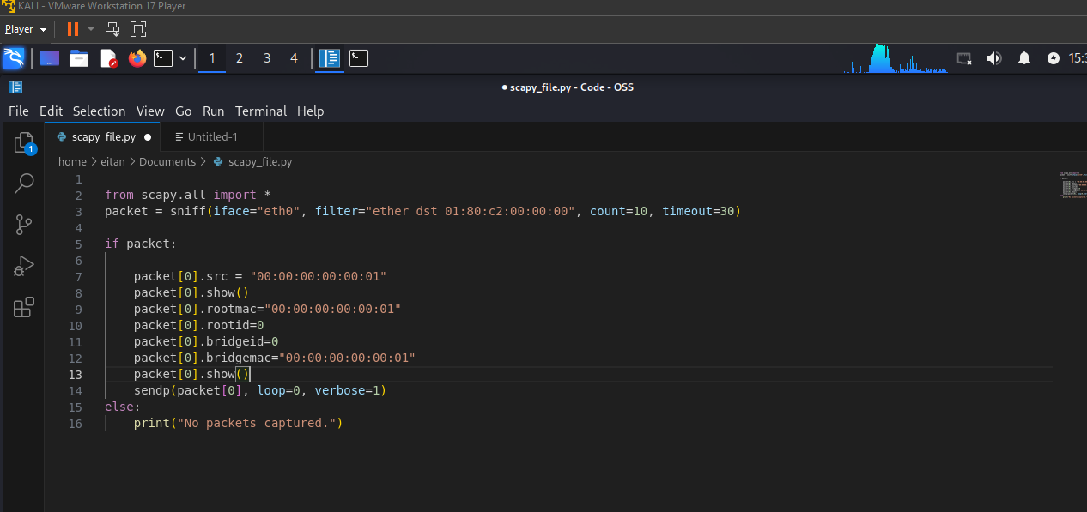

Slide 6
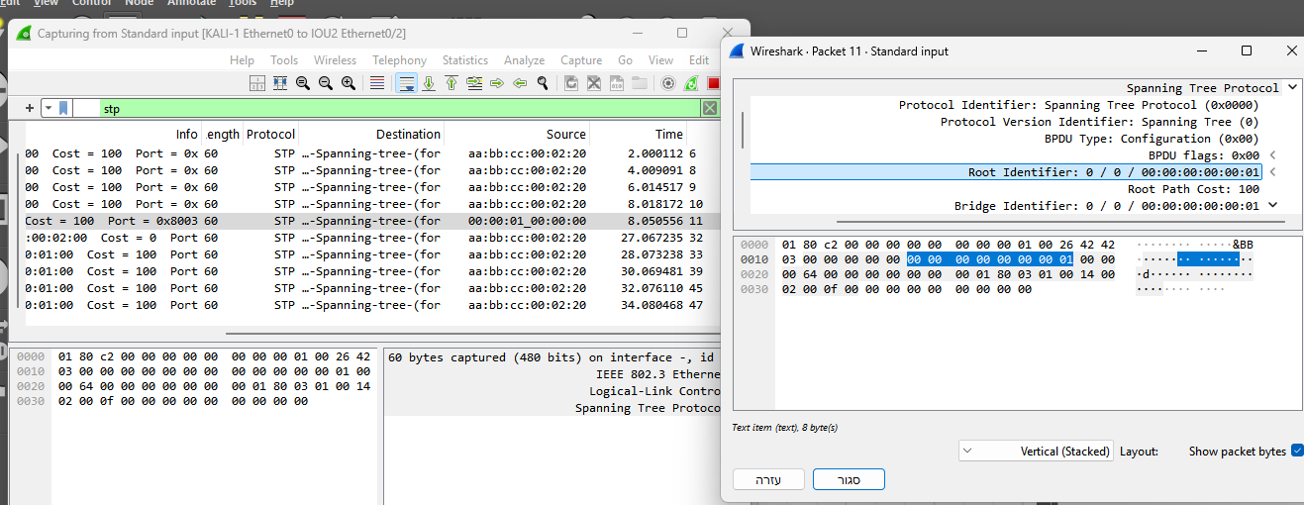

Slide 7
